Slide 1
Optuna
The Agnostic Tuner

Slide 2
How Do We Build Models Again?
That’s it, we are done right?
Not Quite.
Load / Shuffle Data
Select X & Y Data
df = pd.read_csv(
"file.csv"
)
df = shuffle(
df,
random_state=42
)
Split Dataset
X = df.drop(
columns=['price']
)
y = df['price']
Build Model
X_train, X_test, y_train, y_test = train_test_split(X, y, test_size = 0.2, random_state = 42)
Fit Model
baseline = XGBRegressor(
objective='reg:squarederror',
random_state=42,
n_jobs = -1
)
Test Model
baseline.fit(
X_train,
y_train
)
baseline_pred = baseline.predict(
X_test
)
baseline_rmse =
mean_squared_error(
y_test,
baseline_pred,
squared=False
)
print(
"Baseline RMSE (log scale):",
baseline_rmse
)
Confidential

Slide 3
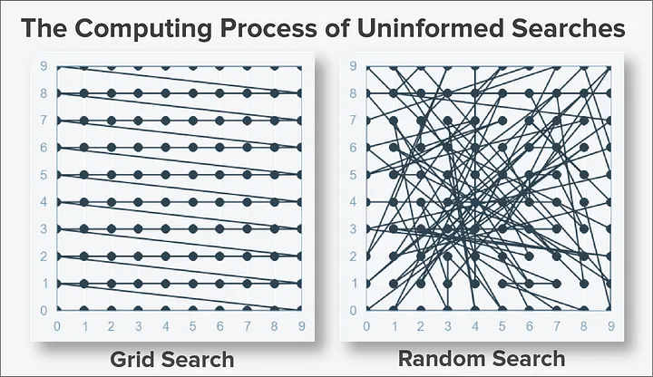
Grid & Random Search
Grid Search:
Random Search:
Exhaustive / Brute-Force Tuning the evaluates every combination of values.
Pro:
Will find best result within grid.
Easy to use.
Cons:
Slow and Expensive
Ineffective with higher-dimensional parameter spaces.
Can only produce limited accuracy
.
Randomly selects values from each parameter.
Pro:
Value selection is not locked to a grid.
Runs a set number of trials.
Cons:
No guarantee it will find the best solution.
Produces inconsistent results.
Wasteful for small models with few parameters.
Notes:
Grid: Better with Few Hyperparameters / Small Datasets
Worse: Large Datasets, deep learning, large / complex / continuous spaces
Random:
Better: More efficient with higher dimensional data then Grid, Searches spectrum of values instead of set values.
Common Practice: Start with Random Search to discover narrower parameter ranges, then switch to Grid Search.
Random

Slide 4
What Is Optuna?
Pros:
Bayesian Optimization
A hyperparameter tuning library that uses Bayesian Optimization by implementing Tree-structured Parzen Estimator.
Optuna is:
Will find best results with few interactions then Grid or Random Search.
Can automatically stop bad trials.
Can be used with Neural Networks, XGBoost, you name it.
Come with easy to use out of the box visualizations.
WHAT?
Bayesian Optimization
An Optimization Strategy that uses previous trials results to inform the behavior of future trials. This is not code.
The specific Algorithm Optuna uses to implement Bayesian Optimization
Cons:
Tree-structured Parrzen Estimator
Takes longer to set up then Grid or Random Search.
A little overkill for small datasets where Random could be a better fit.
Still produces a little randomization in its results.
Confidential

Slide 5
Optuna Structure
Major Components
What This All Looks Like
Objective Function
Objective Function
Where the tuning method is defined and the tuning takes place.
Build Model
Study
Fit Model
Variable that hold the results of each trial.
Evaluate Model
Trial
Return Results
How many times the model should be tuned to find the best results.
Study
=
Call Method
( Number of Trials)

Slide 6
Optuna Features
Setting Your Hyper Parameters
Some of the Build in Visualizations
As a Fixed Value
n_layers = 2
Optimization History Plot
vis.plot_optimization_history(study)
As a Value in a List
n_layers =
trail.suggest_categorical(
‘n_layers, [1,2,3]
)
Hyperparameter Importance
vis.plot_param_importance(study)
Slice Plot(s)
vis.plot_slice(study, params = [‘n_extimators’, …])
As a Values Within a Range
n_layers = trail.suggest_int(
‘n_layers, 1,5
)
Import: import optuna.visualization as vis
vis.plot_intermediate_values()
vis.plot_edf()
vis.plot_rank()
vis.plot_parallel_coordinate()
vis.plot_contour()
vis.plot_timeline()
Notes:
Optuna Dashboard: https://github.com/optuna/optuna-dashboard

Slide 7


Summary of Results
Grid Search
Optuna XGBoost: 100 Trials
Optuna Neural Network: 30 Trials
Score
1.172322
Score
1.172373
Score
1.192162
Tuning Time
81.88 minutes
Tuning Time
3.92 minutes
Tuning Time
28.38 minutes
Random Search: 200 Trials
Optuna XGBoost GPU
Score
1.172177
Score
1.171112
Tuning Time
14.14 minutes
Tuning Time
4.95 minutes.
Confidential

